Slide 1

Inheritance
What is Inheritance, and why is it so powerful?
We can look at Inheritance as a form of code re-use.
It's a way to organize classes into a parent-child hierarchy, which lets the child inherit (re-use), fields and methods from its parent.
COMPLETE JAVA MASTERCLASS
Inheritance - Part 1

Slide 2
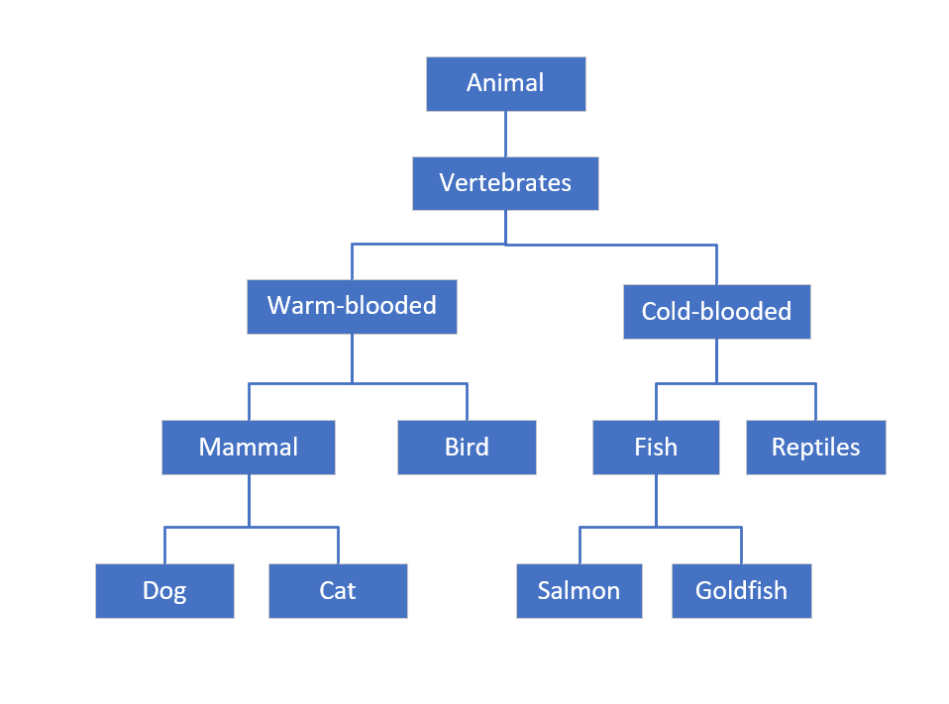
Inheritance
Each box on this diagram represents a Class.
The most generic, or base class, starts at the top of the hierarchy.
Every class below it is a subclass.
So Animal is the base class. All the other classes can be said to be subclasses of Animal.
A parent can have multiple children, as we see with Mammal, which is the parent of Dog and Cat.
A child can only have one direct parent, in Java
But it will inherit from its parent class's parent, and so on.
COMPLETE JAVA MASTERCLASS
Inheritance - Part 1

Slide 3
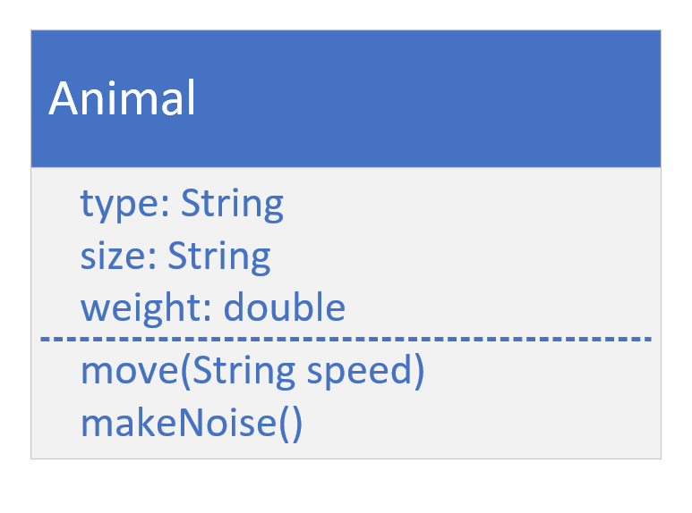
The Animal class
A class diagram, allows us to design our classes before we build them.
This diagram shows the Animal class, with the attributes we think that every kind of animal has.
Below the fields, we have the behavior that animals have in common, move, and makeNoise.
COMPLETE JAVA MASTERCLASS
Inheritance - Part 1

Slide 4
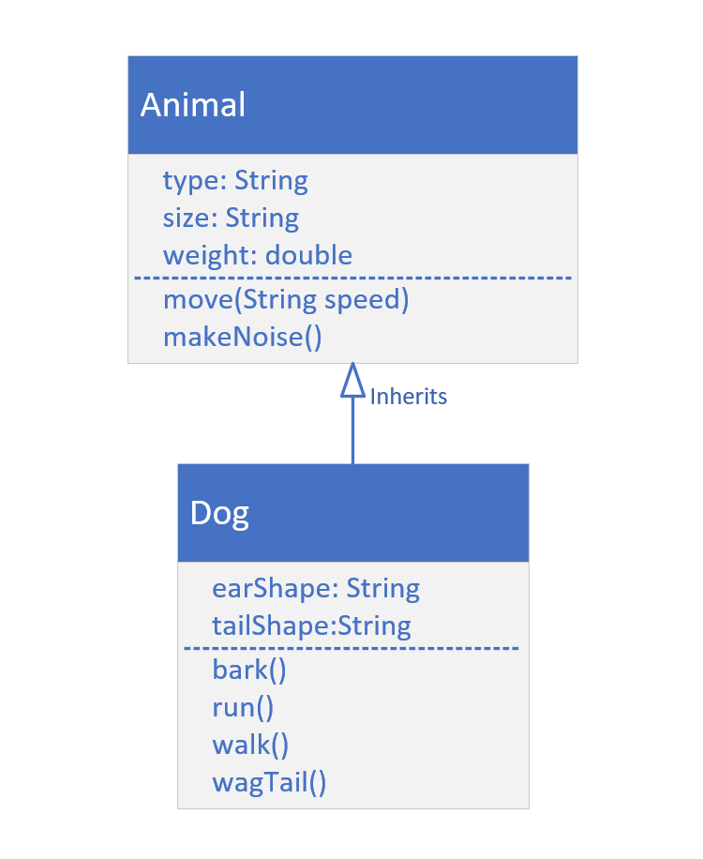
Class Model for Animal and Dog
Dog inherits from Animal.
In other words, Dog 'IS A' type of Animal.
When we create a Dog object, it will inherit Animal's attributes (type, size and weight).
This is also true for Animal's methods. Dog will inherit these as well.
We can specialize the Dog class with its own fields and behavior.
COMPLETE JAVA MASTERCLASS
Inheritance - Part 1

Slide 5
extends
Using extends specifies the superclass (or the parent class) of the class we're declaring.
We can say Dog is a subclass, or child class, of Animal.
We can say Animal is a parent, or super class, of Dog.
A class can specify one, and only one, class in its extends clause.
COMPLETE JAVA MASTERCLASS
Inheritance - Part 1

Slide 6
super()
super() is a lot like this().
It's a way to call a constructor on the super class, directly from the sub class's constructor.
Like this(), it has to be the first statement of the constructor.
Because of that rule, this() and super() can never be called from the same constructor.
COMPLETE JAVA MASTERCLASS
Inheritance - Part 1

Slide 7
super()
If you don't make a call to super(), then Java makes it for you, using super's default constructor.
If your super class doesn't have a default constructor, than you must explicitly call super() in all of your constructors, passing the right arguments to that constructor.
COMPLETE JAVA MASTERCLASS
Inheritance - Part 1

